Slide 1

NIDA Center for GWAS in Outbred Rats
Abraham Palmer
Department of Psychiatry
University of California San Diego

Slide 2
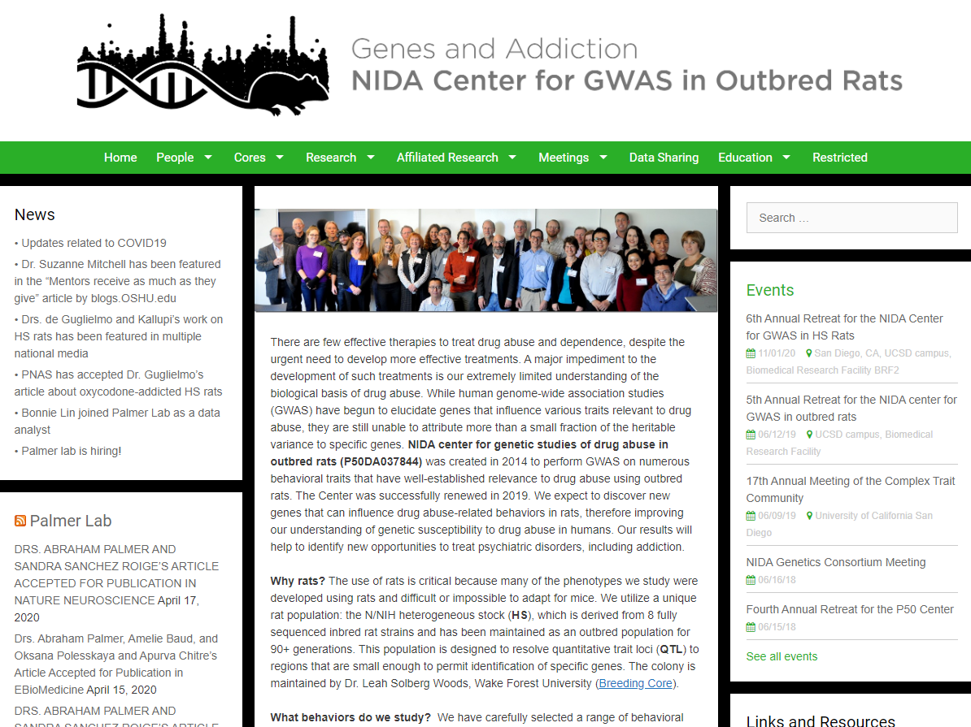

Slide 3
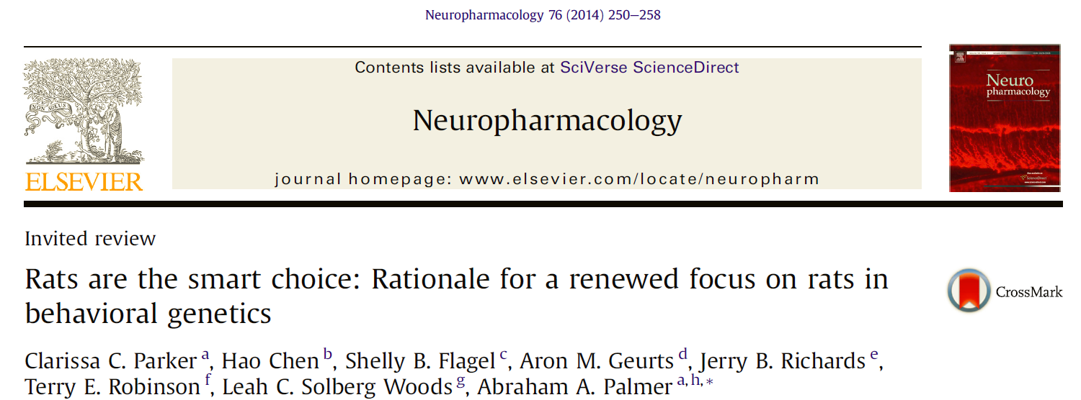

Slide 4
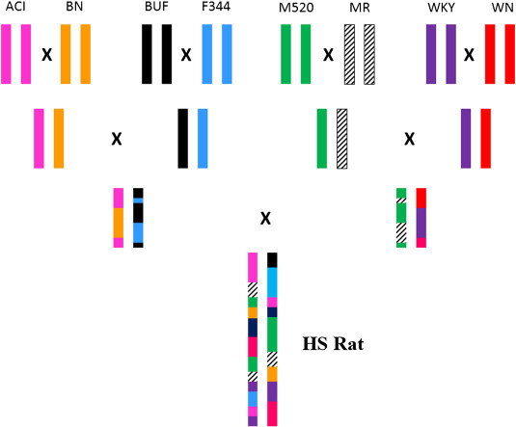
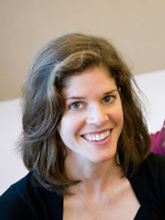
N/NIH Heterogeneous stock (HS) rats
1984
Leah Solberg Woods
Currently at generation 94

Slide 5
1984: Colony initiated and maintained at NIH
  60 breeder pairs, random mating
2003: colony transferred to Northwestern University (Dr. Eva Redei)
  25 breeder pairs
2006: colony transferred to Medical College of Wisconsin (MCW; Dr. Solberg Woods)
  46 breeder pairs, circular mating (minimizes inbreeding and controls genetic drift)
  2014: increase to 64 breeder pairs, use mating program to mate distantly related pairs
2016: colony transferred to Wake Forest School of Medicine (WFSM; Dr. Solberg Woods)
  40 breeder pairs, mating program to mate distantly related pairs
  2019: increase to 92 breeder pairs, mating program to mate distantly related pairs
2020: embryo cryopreservation at RRRC (2,876 zygotes from 75 breeding pairs)

Slide 6
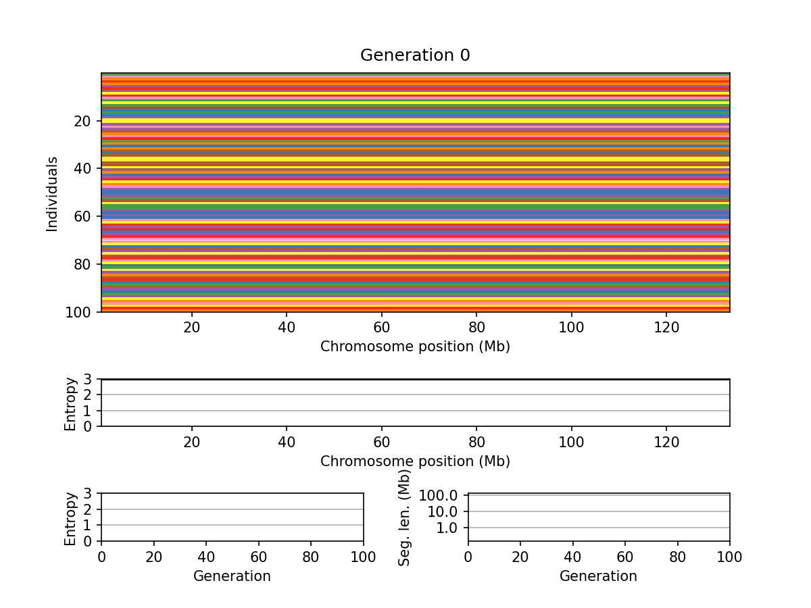

Rotational breeding, assuming 50 breeding pairs/generation
Dan Munro

Slide 7
Unlike other species, there is no inexpensive microarray for genotyping rats
  One limitation of microarrays is that they are specific for a given population
  Also, the design and unit cost of microarrays is relatively high
Since about 2012, of our mouse and rat work genotyping has relied of sequencing based methods, followed by imputation
Until recently, we have relied on genotyping by sequencing (GBS) which is adapted from plant genetics
We have now transitioned to low-pass whole genome sequencing
  ~0.25x coverage is sufficient
  Imputation using STITCH or Beagle->Impute2
  Overtime this will provide us with deep coverage of the existing HS haplotypes, which may differ from available HS founder samples

Slide 8

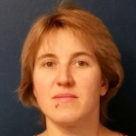
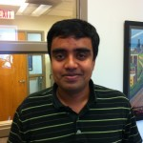
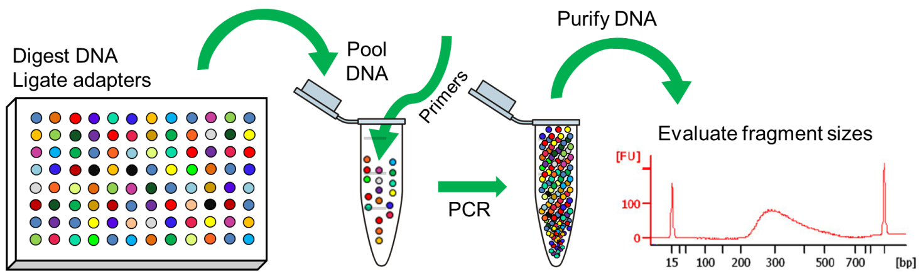


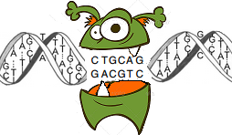
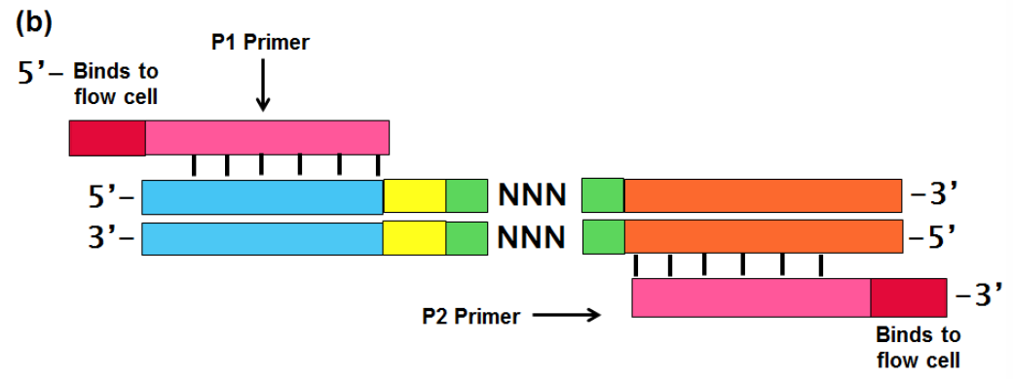
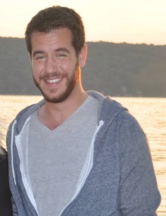
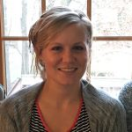
Genotype by sequencing (GBS)
Natalia Gonzales
Oksana Polesskaya
Shyam
Gopalakrishnan
Emmanuel Aryee
Jianjn Gao
Alex Gileta
Hannah
Bimschlager

Slide 9

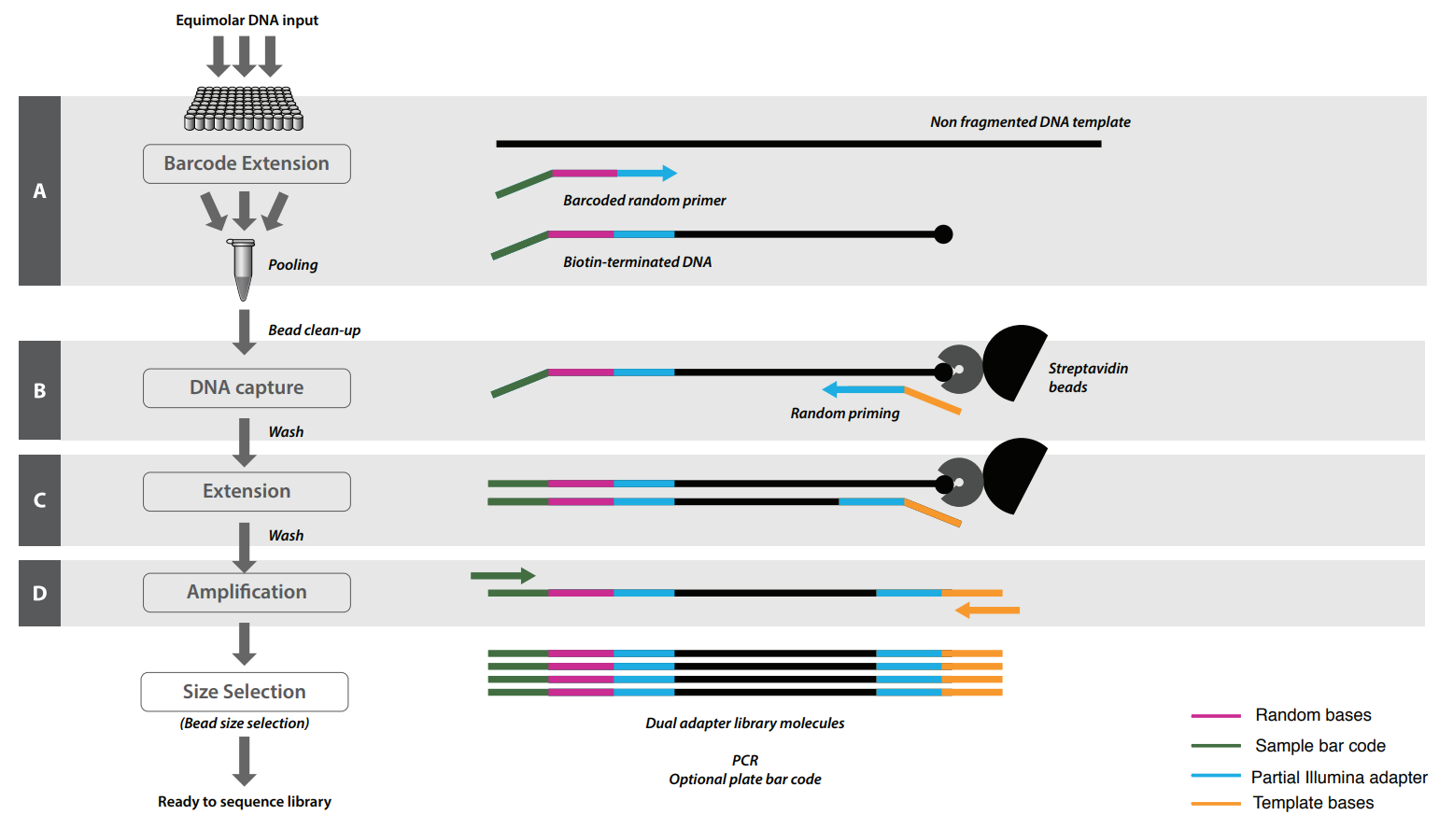
Riptide protocol
Now transitioning to the new rat genome mRatBN7!
Notes:
We then genotyped 1161 CFW mice using a genotyping by sequencing approach.
I don’t have time to go into the details of how this is accomplished, but the take home message is that it generates tens of thousands of single nucleotide polymorphisms (SNPs) for use in genetic analyses.
And its cheap---the cost per sample is $70/sample and expected to drop, as compared to about $90/sample in the MegaMuga.
Furthermore, many of the SNPS in the Megamuga would be uninformative in our CFW mice---we would only have about 20-30K informative SNPs, as compared to the approximately 90k that we get via GBS.
Historically, its been primarily used to genotype maize genomes, but we have successfully conducted GBS in these outbred mice.
Natalia Gonzales and Alex Gileta are both attending this conference and presenting their GBS results; and I’m sure they’d be more than happy to answer any questions you have about this approach.

Slide 10
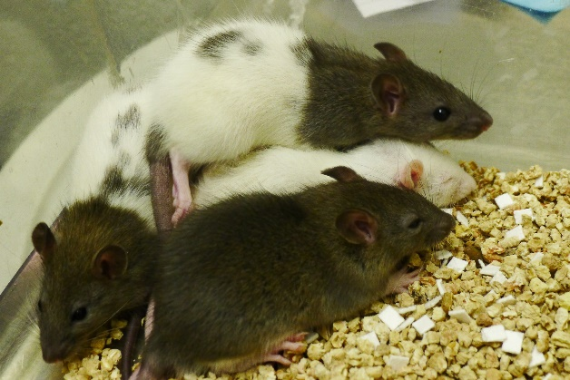
Center goals
Use quantitative genetics to identify genes that influence a constellation of psychologically complex behavioral traits that are associated with drug abuse
  Rats not mice
  Outbred HS rats
  Next gen sequencing to genotype
  Behavioral domain experts
  Very large sample sizes
  Multi-omic data integration
  Analysis pipeline to produce “reports”
Please visit www.ratgenes.org for more information!

Slide 11
Center for GWAS in outbred rats
The key elements of the center
  Production of HS rats
  Phenotyping of HS rats
  Genotyping of HS rats
  Analysis of genotype and phenotype data

Slide 12
Initial Funding Period: 2014-2019
Core A: Administrative core (UChicago/UCSD)
Research Project 1: Incentive salience (UofM)
Core B: HS breeding (MCW/WFU)
Research Project 2:
Nicotine Self-admin (UTHSC)
Core C: Sequencing (UChicago/UCSD)
Research Project 4: Analysis (UChicago/UCSD)
Research Project 3: Behavioral
regulation
(RIA)
Core D: Pilot project core (UChicago/UCSD)

Slide 13
Research Project 1 | Research Project 2 | Research Project 3
University of Michigan | University of Tennessee Health Center | University at Buffalo
PIs: Terry Robinson, Shelly Flagel | PI: Hao Chen | PIs: Jerry Richards, Paul Meyer
Pavlovian conditioned approach Conditional reinforcement Novelty seeking Cocaine contextual conditioning | Open field Novel object Elevated Plus Maze Marble burying Social interaction Socially acquired nicotine self-administration Gene expression in 5 brain regions: n=88 per region | Locomotor activity Light reinforcement Reaction time Delay discounting Pavlovian conditioned approach Conditional reinforcement Novelty seeking Cocaine cue preference

Slide 14
Renewal Period: 2019-2024
Core A: Administrative Core (UCSD)
Research Project 1: Intermittent access intravenous self-administration (UB)
Research Project 2:
Nicotine intravenous self-administration (UTHSC) n -> 3,200
Core C: Genotyping, RNASeq and GWAS Core (UCSD)
Core B: HS Breeding Core (WFUSM)
Research Project 4:
Networks (Ideker UCSD)
Research Project 3: Impulsivity and behavioral regulation
(UB) n -> 3,200
Core D: Pilot project Core (UCSD)

Slide 15
Research Project 1 | Research Project 2 | Research Project 3
University at Buffalo | University of Tennessee Health Center | University at Buffalo
PIs: Paul Meyer | PI: Hao Chen | PIs: David Dietz (PI), Keita Ishiwari (coI), Paul Meyer (coI), Suzanne Mitchell (coI)
Intermittent access cocaine self administration Gene expression in 3 brain regions following either intermittent or extended access cocaine | Open field Novel object Elevated Plus Maze Marble burying Social interaction Socially acquired nicotine self-administration Gene expression in 5 brain regions for eQTL | Locomotor activity Light reinforcement Reaction time Delay discounting Pavlovian conditioned approach Conditional reinforcement Novelty seeking Cocaine cue preference

Slide 16
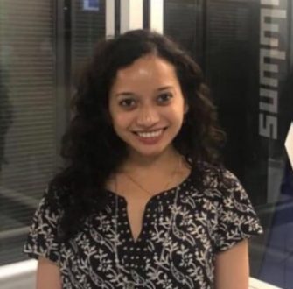
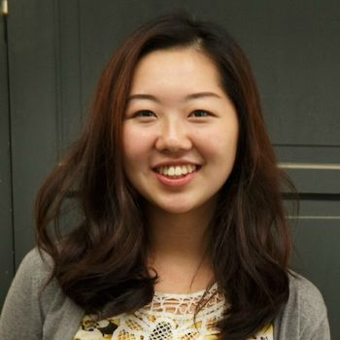
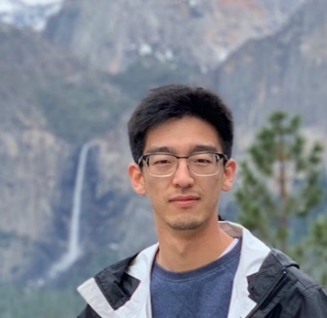

Database
Breeding/
Demographic
**RFID
Glucose
**RFID
Physiological phenotypes
(collaborations)
**RFID
Tissue
Data
Apurva Chitre
Weight
**RFID
Dissection
**RFID
Tissue weight, location
Shipments
**RFID
Tissue location
Behavioral
**RFID
Raw metrics
Calculated metrics
Raw data filenames
Video files
**Filename
Bonnie Lim
Raw text files
**Filename
PostgreSQL
Cagemates
**RFID
Protocol
**Protocol Name
Version
Denghui Chen

Slide 17
Numerous U01s and other grants have benefitted from two key cores in this center
Core C: Sequencing and GWAS asnalaysis (UCSD)
Core B: HS breeding (WFU)

Slide 18
Physiological collaborations
 | Collaborator | Institution | Area of Interest | Tissue | Grant
1 | Arimantas Lionikas | University of Aberdeen, UK | muscle-tendon-bone | hind limb | None
2 | Diethard Tautz | Max Planck Institute, Germany | evolution | heads | None
3 | Cheryl Ackert-Bicknell Douglas Adams | University of Colorado, Denver | musculoskeletal research | carcass, limbs | Funded R01
4 | Leah Solberg-Woods Kevin Regner | Wake Forest University, US Medical College of Wisconsin | type 2 diabetes | serum, fat, liver, muscle | Funded State of Wisconsin Grant
5 | Amelie Baud, John Cryan, Rob Knight | UCSD, University College Cork, Ireland | microbiome | cecum, fecal material | Funded pilot from CMI
6 | Matthew Dean | University of South California, US | evolutionary biology | baculum | None
7 | Amelie Baud | EMBL-EBI, UK | indirect genetic effects | cage mates info | None
8 | Mohit Jain | UC San Diego, US | metabolomics | serum, brain | None
9 | Francesca Telese | UC San Diego, US | epigenetics | brain tissue | Funded U01
10 | Derek Daniels | University at Buffalo, US | feeding behaviors | food and water consumptions | None
11 | Monica Jablonski | University of Tennessee, US | retinal biology | eyes | Funded R01
12 | Chris Vulpe | University of Florida, US | copper and iron metab | liver, serum | None
13 | Michael R. Garrett | University of Mississippi, US | Renal physiology | kidney | R01 being resubmitted
14 | Joe Nadeau | University of Maine | noise/signal structure | phenotypic data | None
Notes:
Center established collaborations with 8 laboratories across the world. These laboratories are interested in biological questions not related to drug abuse, but they would like to utilize HS population and our ability to perform GWAS, this is an opportunity for them to find variants involved in regulation of their phenotype of interest. For example, NNN.
In addition, using same rats for additional studies is an ethical thing to do, since animals are used more efficiently. Administrative core provides an initial point of contact for these collaborators, then works on establishing dissection protocols, oversees sample shipping and then maintains communications with researchers in order to do GWAS and publish the results.
This core also handles requests to use HS rats (1) and GBS genotyping services (2).

Slide 19
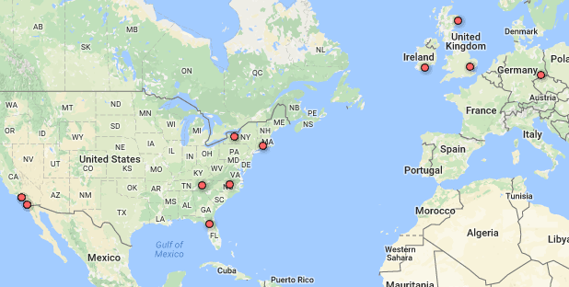
Spin-off grants (funded)
 | Investigators | Grant # | Title | Funded by
1 | Shelly Flagel | R01 DA038599 | Dynamic Control of Cue-Driven Behavior Via the Paraventricular Thalamic Nucleus | NIDA
2 | Paul Meyer | R01 AA024112 | Nicotine amplification of behavioral and neural responses to alcohol cues. | NIAAA
4 | Douglas Adams | R01 AR070879 | Identification of Genes Regulating Bone Matrix Composition and Quality | NIAMS
3 | Leah Solberg-Woods & Kevin Regner (MPI) | Awarded | Genetic Mapping and Gene Identification in Acute Kidney Injury Using Outbred Rats | HWE/MCW
5 | Oksana Polesskaya & Amelie Baud | Awarded | Genetics of microbiome in HS rats | CMI/UCSD
6 | Huda Akil & Jun Li | U01 DA043098 | Genetics of Novelty seeking and Propensity for Drug Abuse in Outbred Rats | NIDA
7 | Olivier George & Abraham Palmer (MPI) | U01 DA043799 | Identification of Genetic Variants that Contribute to Compulsive Cocaine Intake in Rats | NIDA
8 | Olivier George & Abraham Palmer (MPI) | U01 DA044451 | Use of Next-Gen Sequencing to Identify Genetic Variants that Influence Compulsive Oxycodone Intake in Outbred Rats | NIDA
9 | Thomas Jhou | U01 DA044468 | Genomic analysis of avoidance learning in addiction | NIDA
10 | Suzanne Mitchell & Bob Hitzemann (MPI) | U01 DA046077 | Identification of genetic features of delay discounting using a heterogeneous stock rat model | NIDA
11 | Monica Jablonski | R01 EY021200 | Genetic Modulation of Glaucoma | NEI
12 | Peter Kalivas, et al | U01 DA45300 | The Genetic Basis of Opioid Dependence Vulnerability in a Rodent Model | NIDA
13 | Francesca Telese | U01 DA050239 | Single-Cell Resolution Analysis of Chromatin Accessibility and Gene Expression Changes in a Model Of Drug Addiction | NIDA

Slide 20
Project | Tissue | # samples
P50 DA037844 (Chen, Palmer) | nucleus accumbens core | 88
P50 DA037844 (Chen, Palmer) | lateral habenula | 88
P50 DA037844 (Chen, Palmer) | orbitofrontal cortex | 88
P50 DA037844 (Chen, Palmer) | infralimbic cortex | 88
P50 DA037844 (Chen, Palmer) | prelimbic cortex | 88
P50 DA037844 (Chen, Palmer) | posterior ventral tegmental area | 100
P50 DA037844 (Chen, Palmer) | medial habenula | 100
P50 DA037844 (Chen, Palmer) | ventral hippocampus | 100
P50 DA037844 (Chen, Palmer) | insular cortex | 100
P50 DA037844 (Chen, Palmer) | lateral hypothalamus | 100
U01 DA050239 (Telese) | nucleus accumbens | 100
R01 EY021200 (Jablonsky) | Eye | 50
P50 DA037844 (Chen, Telese, Palmer) | Half brain (sagittal) | 350
U01DA046077 (Mitchell, Hitzemann) | Basolateral amygdala | 200
U01DA046077 (Mitchell, Hitzemann) | Prelimbic cortex | 200
U01DA044468 (Jhou) | rostromedial tegmental nucleus | 80
U01DA044468 (Jhou) | rostromedial tegmental nucleus | 80
U01DA044468 (Jhou) | rostromedial tegmental nucleus | 80
U01DA044468 (Jhou) | rostromedial tegmental nucleus | 80

Slide 21
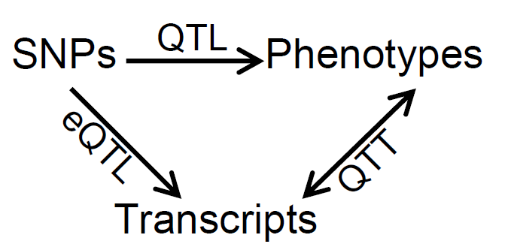

Slide 22
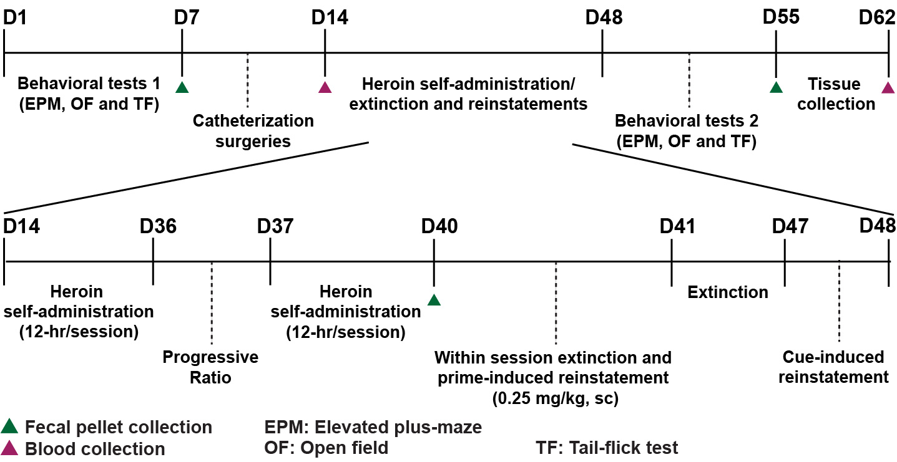
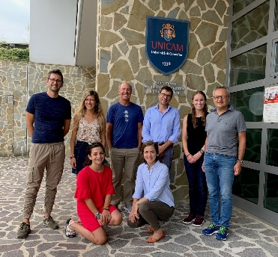
The Genetic Basis of Opioid Dependence Vulnerability in a Rodent Model (U01DA045300; Kalivas)
The team
(Refraining)

Slide 23
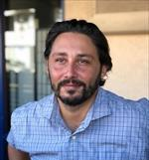
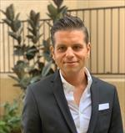
Identification of Genetic Variants that Contribute to Compulsive Cocaine Intake in Rats (U01DA043799; George)
Olivier George
Giordano De Guglielmo

Slide 24
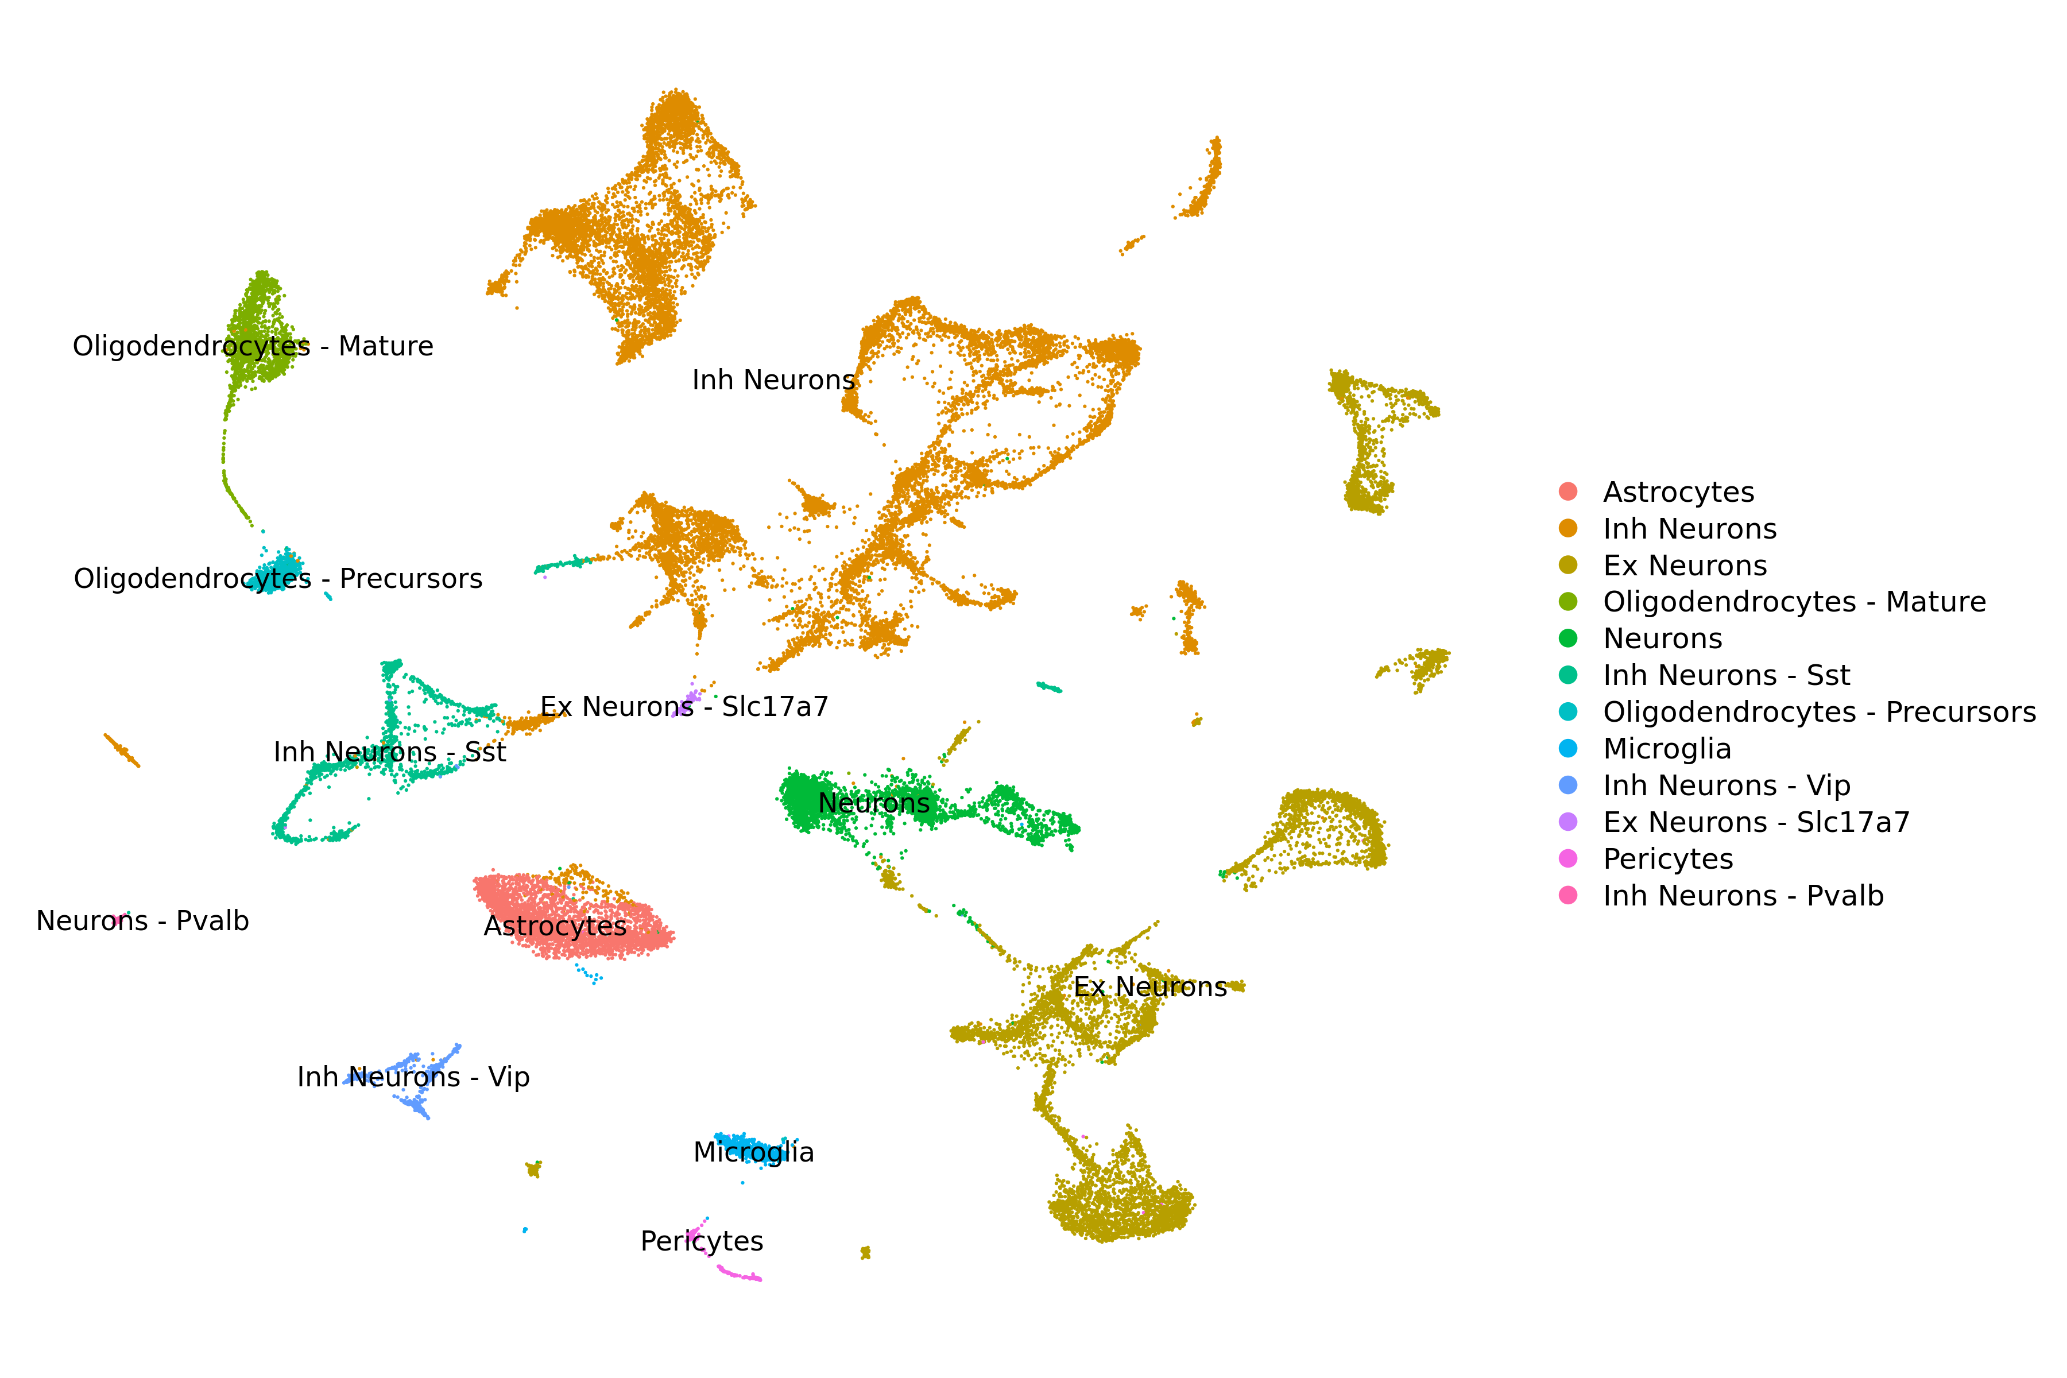
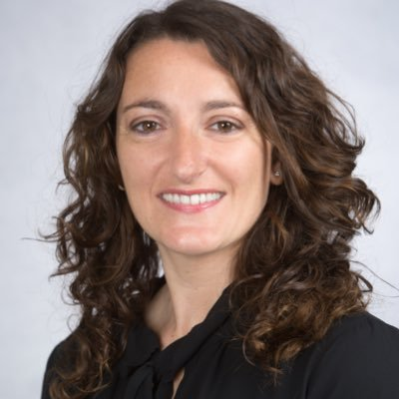
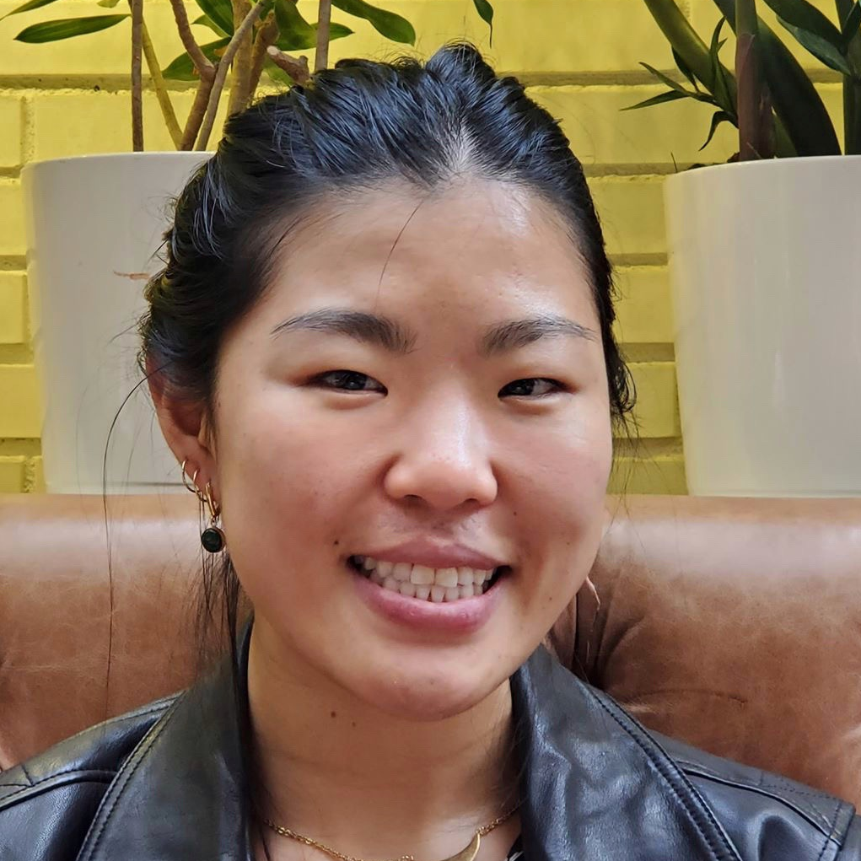
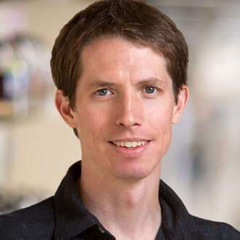
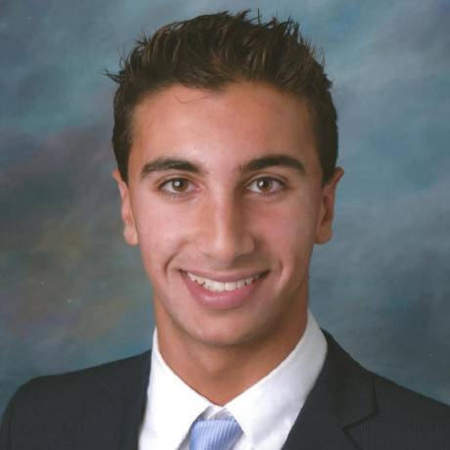
Single-Cell Resolution Analysis of Chromatin Accessibility and Gene Expression Changes in a Model Of Drug Addiction (U01DA050239)
Francesca Telese
Jessica Zhou
Graham McVicker
Arya Massarat

Slide 25
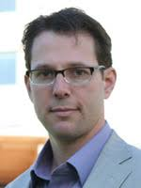
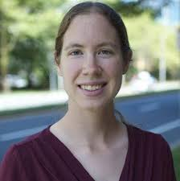
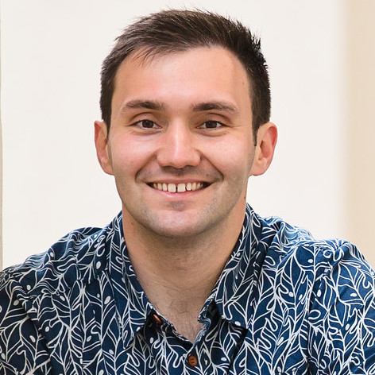
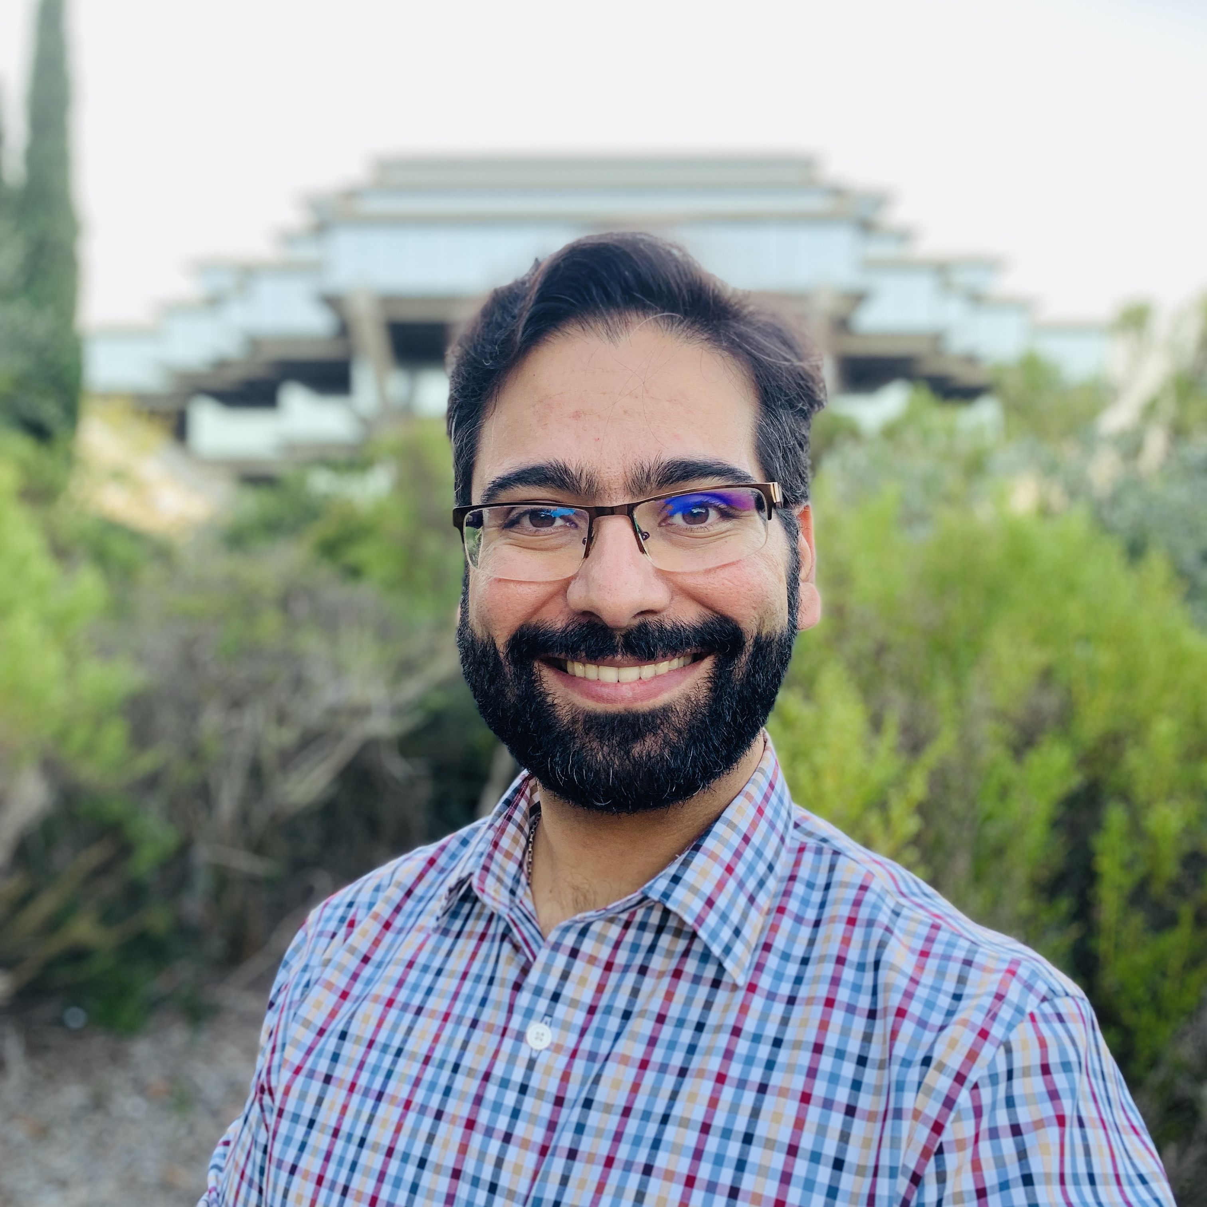
Characterization of Tandem Repeat and Structural Variants Contributing to Addictive Behaviors in Mice and Rats
(U01DA051234)
Jonathan Sebat
Melissa Gymrek
Mikhail Maksimov
Milad Mortazavi

Slide 26
 | Cohort | Number to be studied | Data sources | Currently funded NIDA U01 and related grants (see Letters of support (LOS) and Dr. Palmer’s existing roles)
Inbred mice | BXD | 155 (see LOS from Williams) | Illumina pe150 35x available, this grant will generate PacBio | U01DA041632; Gene variants for nicotine withdrawal deficits in learning (Thomas Gould, see LOS) LOS from Rob Williams also included
 | HMDP | 85 (HMDP is n= 114 but 29 are also in BXD RIs; Ghazalpour, et al 2012) | This grant will generate PacBio and Illumina for the subset for which it is not already available | U01DA044399; Computational methods for identification of genetic factors affecting the response to drug abuse (Gary Peltz, see LOS) U01DA041602; Genetic pathways for impulsivity and drug reinforcement: DNA and transcriptome variation in mice (Desmond Smith, see LOS) LOS from Jake Lusis also included
Outbred mice | DO (HS-CC) | 96 for which RNASeq data are available (see LOS) | This grant will generate PacBio and Illumina | P50DA039841; Center for systems neurogenetics of addiction (Elissa Chesler, see LOS, Dr. Palmer is a member of the external advisory board (EAB)) U01DA041579; Genetic risk for methamphetamine abuse (Tamara Richards, see LOS) U01DA043809; Genetic control of addiction by host and microbiome (George Weinstock, see LOS) LOS from Gary Churchill & Steve Munger also included
Inbred rats | HRDP | 96 (These are the 96 that make up the HRDP, see LOS from Dwinell) | Illumina provided by Dwinell (see LOS), this grant will generate PacBio. | R24OD024617; Hybrid rat diversity program (Melinda Dwinell, see LOS, Palmer is on the EAB) R24AA013162; The heritable transcriptome and alcoholism (Boris Tabakoff & Laura Saba, see LOS, Palmer is on EAB) P30DA044223; Center of excellence in transcriptomics, systems genetics and the addictome (Robert Williams and Laura Saba, see LOS, Palmer is on EAB) U01DA047638; System genetics of menthol and nicotine addiction (Hao Chen, see LOS) LOS from Jun Li also included
Outbred rats | HS (N/NIH) | 88 (These will be the same rats for which Dr. Palmer’s P50 center generated RNASeq from five brain regions) | This grant will generate Illumina and PacBio. | P50DA037844; Center for genetic studies of drug abuse in outbred rats (Abraham Palmer in the PI) U01DA043799; Identification of genetic variants that contribute to compulsive cocaine intake (Olivier George, Palmer is MPI) U01DA044451; Use of next-gen sequencing to identify genetic variants that influence compulsive oxycodone intake in outbred rats (Olivier George, Palmer is CoI) U01DA044468; Genomic analysis of avoidance learning in addiction (Tom Jhou, Palmer is CoI) U01DA045300; The genetic basis of opioid dependence vulnerability in rodent model (Peter Kalivas, Palmer CoI) U01DA046077; Identification of genetic features of delay discounting using a heterogeneous stock rat model (Suzanne Mitchell, Palmer is CoI)
Table 1: Populations to be studied and funded projects generating relevant phenotype data.

Slide 27

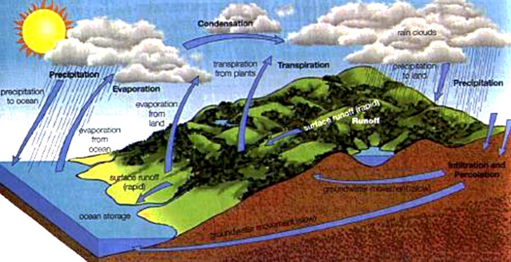
Research Project 1: Incentive salience (U Michigan)
AllofUS-rats
The Ecosystem
Research Project 2:
Nicotine Self-admin (UTHSC)
Research Project 3: Behavioral regulation
(RIA)
U01: Compulsive Cocaine Intake
(George, Palmer UCSD)
Core B: HS breeding (WFU)
Core C: Sequencing (UCSD)
Research Project 4: Analysis (UCSD)
U01 Compulsive Oxycodone Intake (George, Palmer UCSD)
U01 Avoidance learning in addiction (Jhou MUSC)
U01 SV and TRs in mice and rats
(Palmer, Sebat and Gymrek UCSD)
U01 Heroine Self Administration (Kalivas et al, MUSC)
Total sample size from all funded grants 15,696 HS rats
U01 Single Cell RNASeq in Oxycodone Exposed rats
(Telese, UCSD)
U01 Delay discounting (Mitchell, Hitzemann OHSU)

Slide 28
A few quick stories

Slide 29
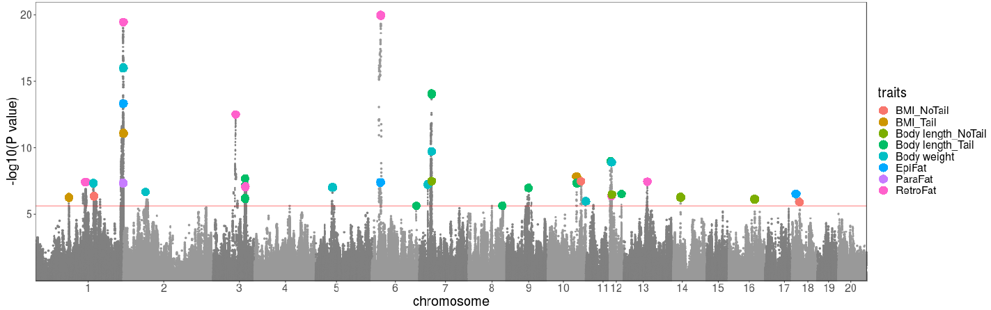
GWAS for body weight (n=3,184; h²= 0.46)
Chitre et al, Obesity, 2020

Slide 30
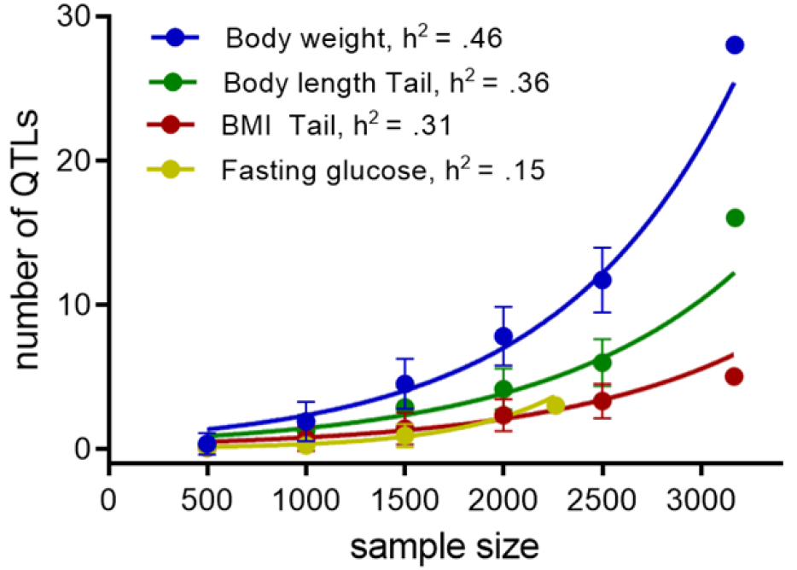
Chitre et al, unpublished

Slide 31
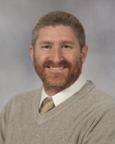
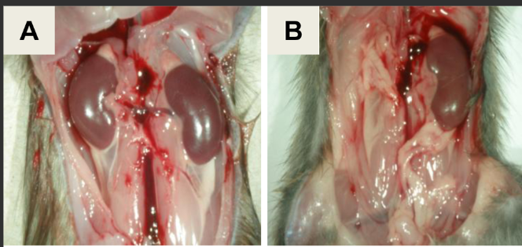
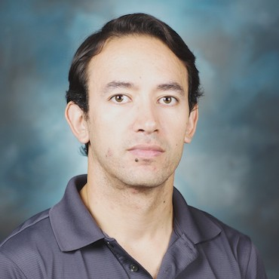
The mystery of the missing kidney…
Michael Garrett
Joel David Leal Gutierrez
Leah Solberg Woods

Slide 32
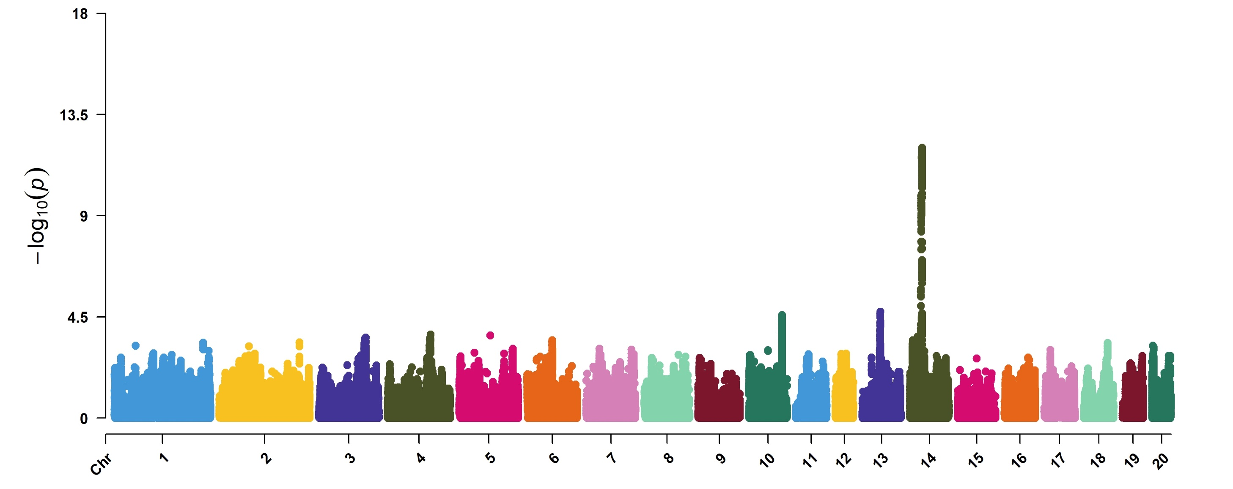
The mystery of the missing kidney…
 | N
Control | 5,576
Case | 110

Slide 33
Microbiome studies
Center for Microbiome Innovation at UCSD is one of the largest in the world
  We have collected Cecum from all P50 rats
  We received a substantial pilot award from the CMI and additional support from Rob Knight himself
we will soon have microbiome (16S) from ~4,800 rats and metabolome in a subset of about 1,100 samples
Questions:
  How does genotype influence microbiome?
  Does microbiome correlated with behavioral and physiological phenotypes?
  Does microbiome correlate with gut metabolome?
  What is the best way to summarize 16S reads into traits for analysis?
Social genetic effects:
  Does the genotype of social partners influence the phenotype of their cagemates?
  If so, might shared microbiome mediate some of these effects?

Slide 34
Reports

Slide 35
file:///C:/Users/Abraham%20Palmer/Downloads/elevated_plus_maze.html

